Slide 1
British Airways
PREDICTING CUSTOMER BUYING BEHAVIOUR
Khoi Bui – 2023/06/25​

Slide 2
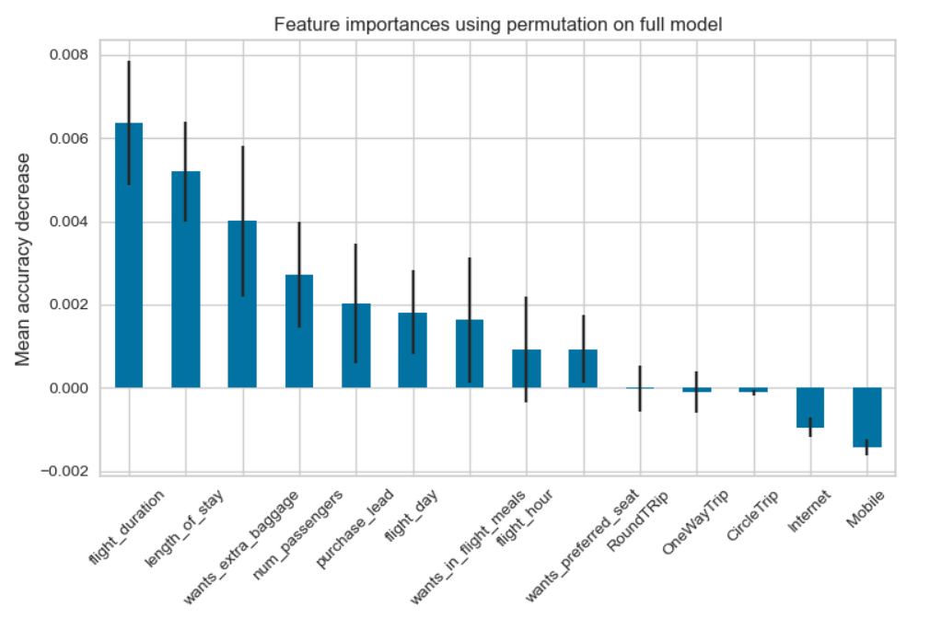
Top features that can drive successful flight bookings.
Flight duration, length of stay, extra baggage are top indicators suggesting a successful flight bookings.
While trip types, sale channels are not as essential
The model achieved an accuracy score of 0.84, indicating an 84% accuracy rate in predicting flight booking completion. The precision score of 0.36 suggests reasonably accurate identification of completed bookings.
However, the F1 score of 0.15 indicates room for improvement in balancing precision and recall. Further analysis and adjustments are recommended to enhance the model's performance.

